Slide 1

A* Heuristics and their Properties
A Presentation By
Soumadip Dey
Assistant Professor, Dept. of Computational Sciences
For Course Code MCA17405(T) of 2025-2026 ODD Semester

Slide 2
Brief Recap regarding Heuristics in A*
A heuristic is a problem-specific strategy or function that estimates the cost from a given state to the goal. In search algorithms like A*, they help guide the search efficiently by prioritizing paths that are more likely to lead to the goal.
In A* search, the heuristic function is denoted as h(n), which estimates the remaining cost from node n to the goal. A* combines this with the actual cost so far g(n) to compute the evaluation function:
f(n) = g(n) + h(n)
g(n) → cost from the start node to the current node.
h(n) → estimated cost from the current node to the goal.

Slide 3
Common Heuristic Measures
Types of Heuristics in A* Search:
Manhattan Distance – sum of horizontal and vertical distances (good for grid-like paths).
Euclidean Distance – straight-line distance between two points.
Chebyshev Distance – maximum of horizontal or vertical distance (used in 8-direction grids).
Hamming Distance – number of misplaced tiles (commonly in puzzles like 8-puzzle).
Misplaced Tiles – counts tiles not in their goal position (used in sliding puzzles).

Slide 4
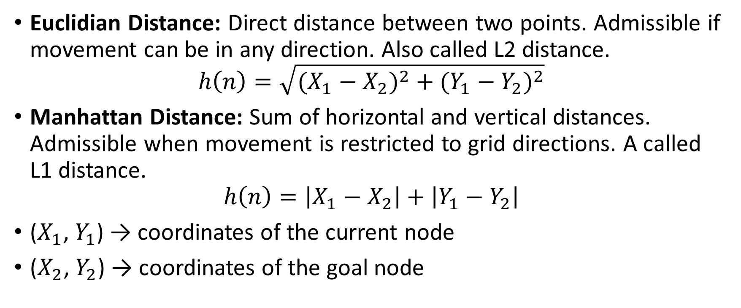
The Heuristics we will focus on:
Euclidian Distance: Direct distance between two points. Admissible if movement can be in any direction. Also called L2 distance.
$$h\left(n\right)=\sqrt{{(X_{1}−X_{2})}^{2}{ + (Y_{1}−Y_{2})}^{2}}$$
Manhattan Distance: Sum of horizontal and vertical distances. Admissible when movement is restricted to grid directions. A called L1 distance.
$$h\left(n\right)=\left|X_{1}−X_{2}\right|+\left|Y_{1}−Y_{2}\right|$$
($X_{1}$, $Y_{1}$) → coordinates of the current node
($X_{2}$, $Y_{2}$) → coordinates of the goal node

Slide 5
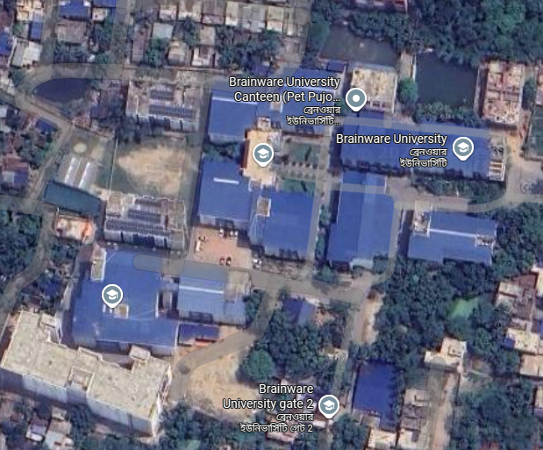
Lets say I want to go from UB-6 to Canteen

Slide 6
Euclidean Distance:

Slide 7
Manhattan Distance:

Slide 8
Which one to Choose?
Here, the Manhattan Distance is chosen since the university campus follows a grid-like layout, and the overall scope is small and I can not travel through/ fly over buildings (Within 9 Acres)

Slide 9
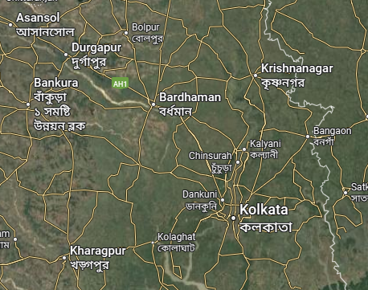
Lets say I want to go from Kolkata to Durgapur

Slide 10
Euclidean Distance:

Slide 11
Manhattan Distance:

Slide 12
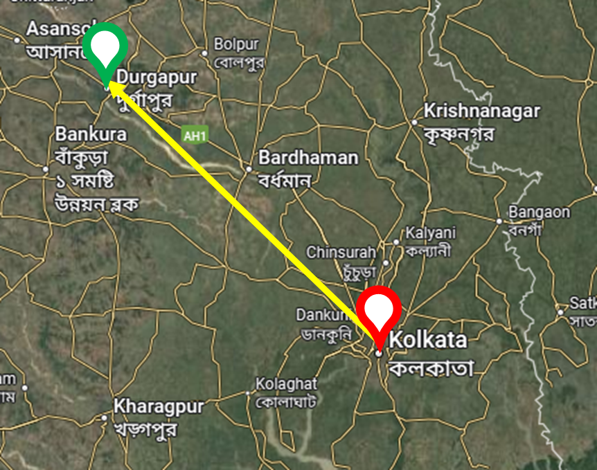
Which one to Choose?
Here, the Euclidean Distance is chosen since the distance is vast and usually high-roads, railways and flight paths follow the straight line tracking the minimum distance.

Slide 13
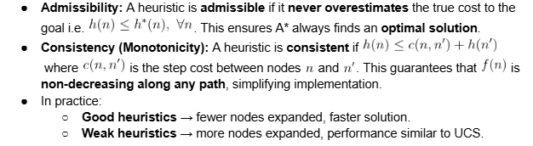
Properties of the Heuristics
There are two properties which help us understand the quality of a heuristic to be used in this case:

Slide 14
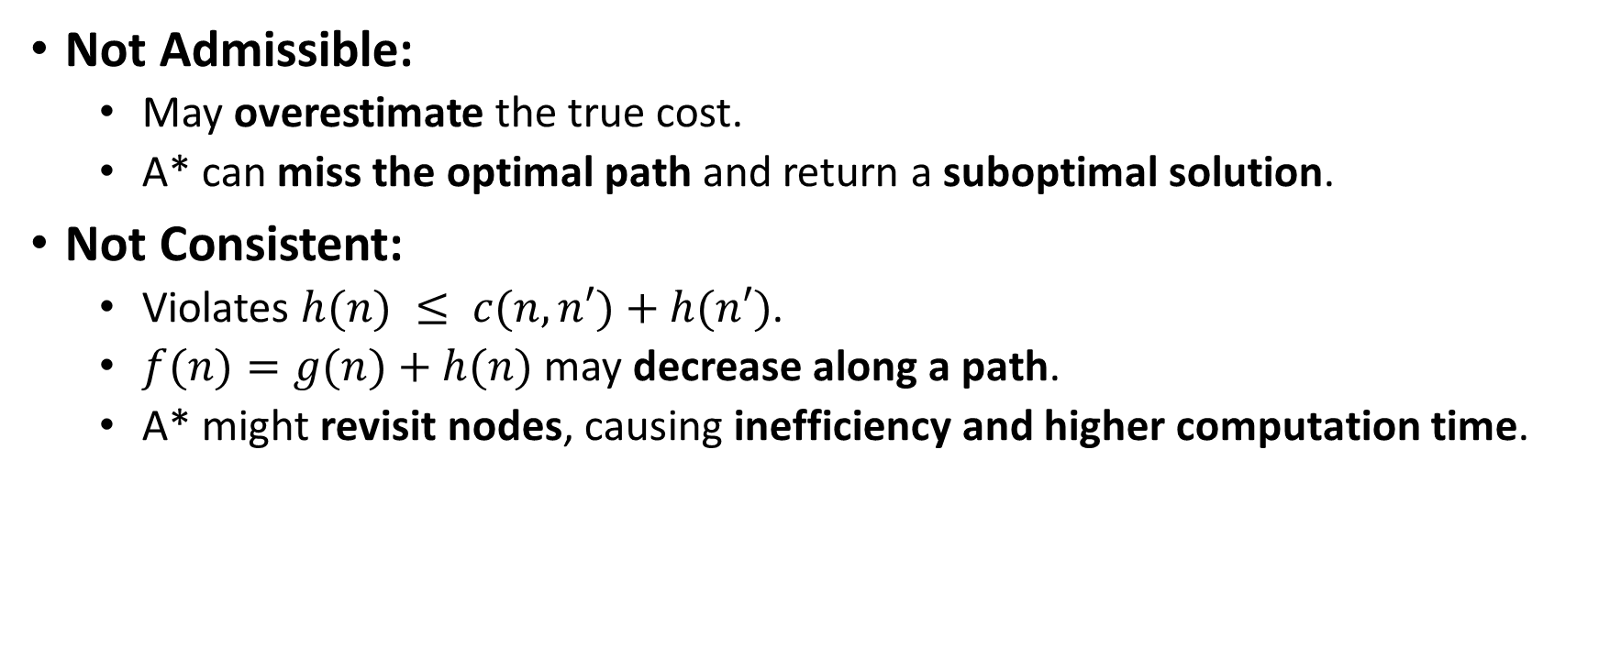
If a Heuristic is Not Admissible or Consistent
Not Admissible:
May overestimate the true cost.
A* can miss the optimal path and return a suboptimal solution.
Not Consistent:
Violates $h(n) ≤ c(n,n′)+h(n′)$.
$f(n)=g(n)+h(n)$may decrease along a path.
A* might revisit nodes, causing inefficiency and higher computation time.

Slide 15
Thank You

